Slide 1
Retail Sales Forecasting Using Time Series Models
L.G.

Slide 2
Objective
Demand Forecast
Predict unit sales
Importance
Accurate forecast – inventory optimization

Slide 3
Data Overview
Corporación Favorita Grocery Sales Forecasting
Region: Guayas
Product Families: Top 3 (Grocery I, Beverages, Cleaning)
Time Range: Jan 01 2013 – March 31 2014
Target Variable: Unit_sales
2,750,000 records

Slide 4
Added features
Lag_1
Lag_7
Lag_30
Is_weekend
Rolling_std_7
Holiday_events

Slide 5
Exploratory Analysis
Key Findings:
  Heavy Influence by whether or not the product is on promotion
  Strong weekly seasonality
Visuals

Slide 6
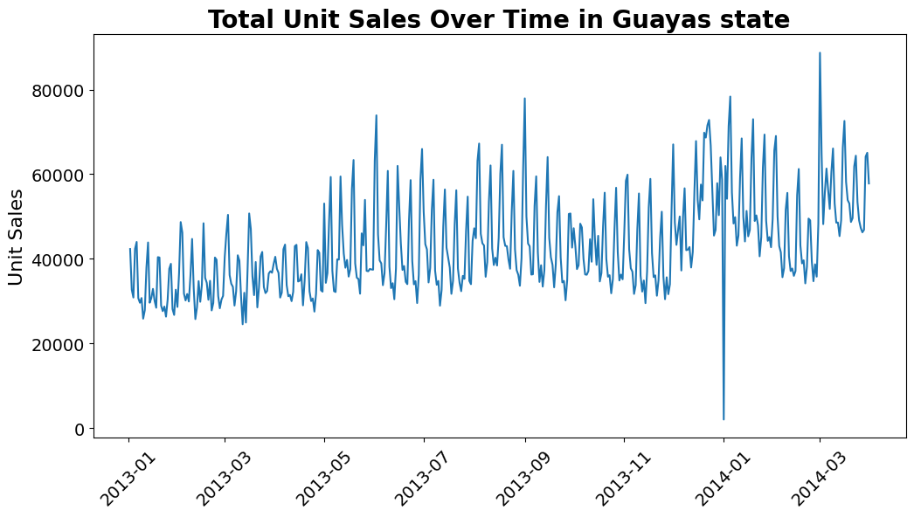
Exploratory Analysis
Key Findings:
  Heavy Influence by whether or not the product is on promotion
  Strong weekly seasonality
Visuals

Slide 7
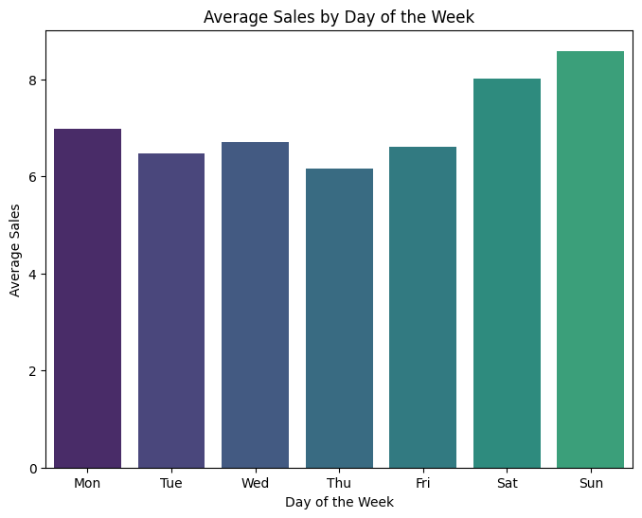
Exploratory Analysis
Key Findings:
  Heavy Influence by whether or not the product is on promotion
  Strong weekly seasonality
Visuals

Slide 8
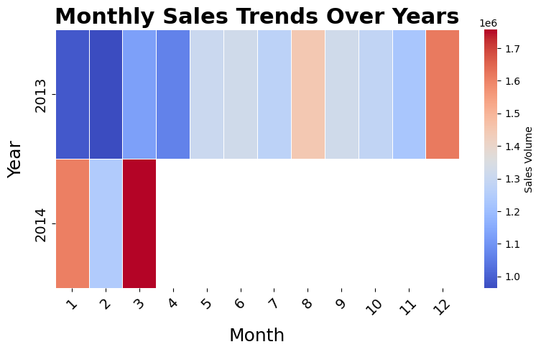
Exploratory Analysis
Key Findings:
  Heavy Influence by whether or not the product is on promotion
  Strong weekly seasonality
Visuals

Slide 9
Models
ARIMA
XGBoost
Exponential Smoothing (Holt-Winters)
Prophet

Slide 10
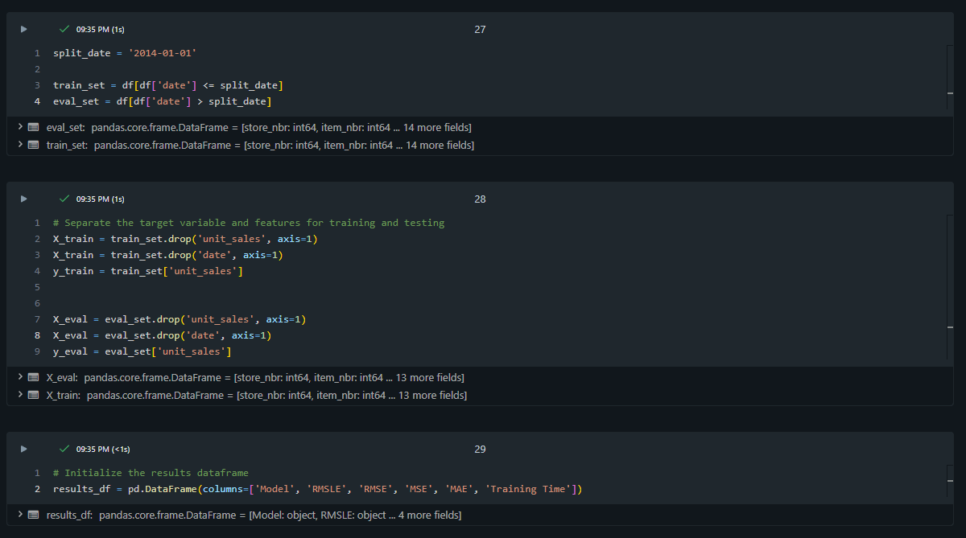
Training Data

Slide 11
Evaluation Matrix
MSE - Mean Squared Error
  Difference between predicted and actual value (Squared)
  Useful for optimizing algorithms
  Basic Evaluation technique

Slide 12
Evaluation Matrix
RMSE - Root Mean Squared Error
  Difference between predicted and actual value
  Sensitive to outliers
  Clearer and more intuitive because it has been square rooted

Slide 13
Evaluation Matrix
RMSLE - Root Mean Squared Logarithmic Error
  Ratio between predicted and actual value
  Unlike RMSE, treats percentage difference as more important than absolute difference
  Deals better with outliers

Slide 14
Evaluation Matrix
MAE – Mean Absolute Error
  Average absolute differences across all datapoints
  Like RMSLE it deals better with outliers
  Does not prioritize large errors over many small ones (All errors treated equally)

Slide 15
ARIMA
Uses past values and errors to predict future steps
First model used as a baseline to compare others to
Useful on aggregated data (e.g. total sales per day)
Less useful for individual items

Slide 16
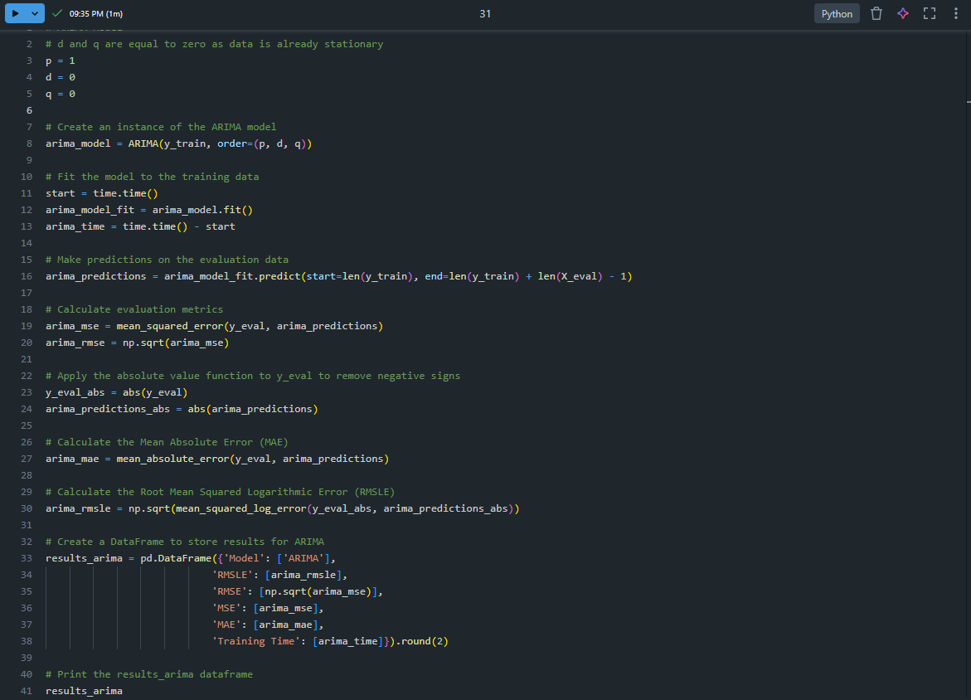
ARIMA
Uses past values and errors to predict future steps
First model used as a baseline to compare others to
Useful on aggregated data (e.g. total sales per day)
Less useful for individual items

Slide 17

ARIMA
Uses past values and errors to predict future steps
First model used as a baseline to compare others to
Useful on aggregated data (e.g. total sales per day)
Less useful for individual items

Slide 18
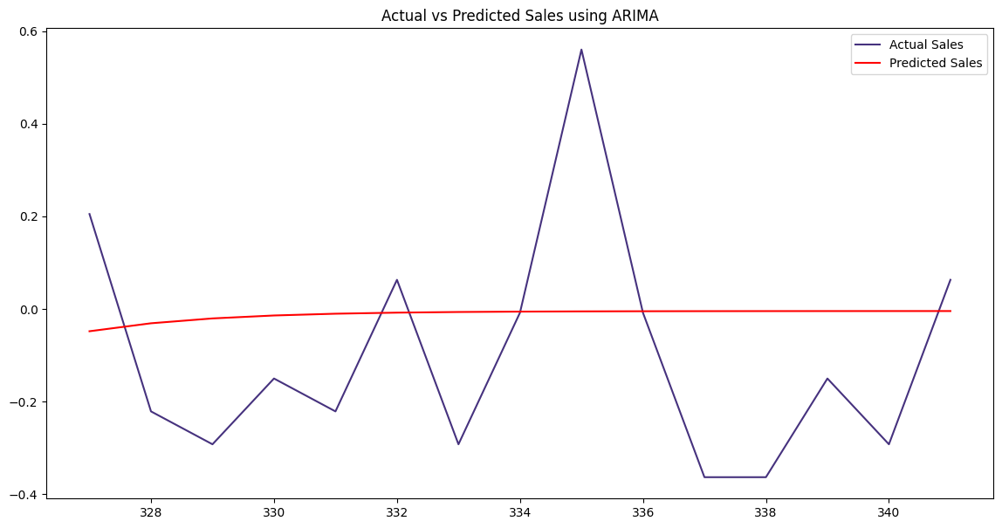
ARIMA
Uses past values and errors to predict future steps
First model used as a baseline to compare others to
Useful on aggregated data (e.g. total sales per day)
Less useful for individual items

Slide 19
XGBoost
Gradient boosted algorithm
  Decision Trees
Handles features like promotion or categorical data well (e.g. items)
  Models like ARIMA struggle with this
Many items have 0 sales on some days
  XGBoost handles this much better than most alternative models
Adding other features such as “holiday events” increased XGBoost accuracy
  As opposed to other models that missed it entirely

Slide 20
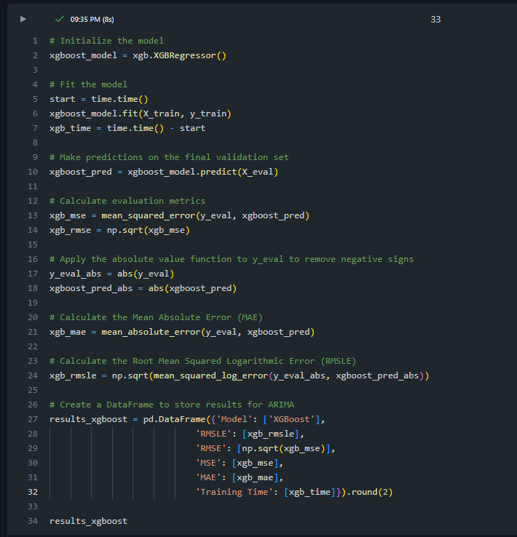
XGBoost
Gradient boosted algorithm
  Decision Trees
Handles features like promotion or categorical data well (e.g. items)
  Models like ARIMA struggle with this
Many items have 0 sales on some days
  XGBoost handles this much better than most alternative models
Adding other features such as “holiday events” increased XGBoost accuracy
  As opposed to other models that missed it entirely

Slide 21

XGBoost
Gradient boosted algorithm
  Decision Trees
Handles features like promotion or categorical data well (e.g. items)
  Models like ARIMA struggle with this
Many items have 0 sales on some days
  XGBoost handles this much better than most alternative models
Adding other features such as “holiday events” increased XGBoost accuracy
  As opposed to other models that missed it entirely

Slide 22
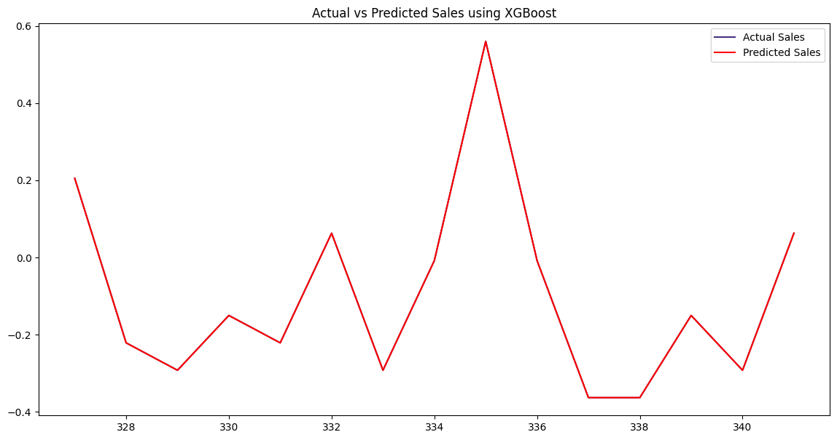
XGBoost
Gradient boosted algorithm
  Decision Trees
Handles features like promotion or categorical data well (e.g. items)
  Models like ARIMA struggle with this
Many items have 0 sales on some days
  XGBoost handles this much better than most alternative models
Adding other features such as “holiday events” increased XGBoost accuracy
  As opposed to other models that missed it entirely

Slide 23
Exponential Smoothing (Holt-Winters)
Simpler does not always mean accurate
Complexity does not always mean slower

Slide 24
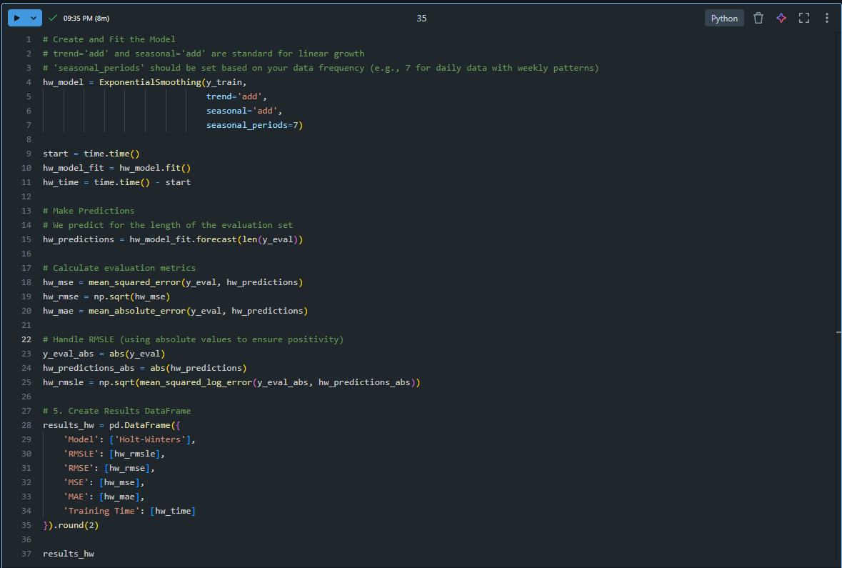
Exponential Smoothing (Holt-Winters)
Simpler does not always mean accurate
Complexity does not always mean slower

Slide 25

Exponential Smoothing (Holt-Winters)
Simpler does not always mean accurate
Complexity does not always mean slower

Slide 26
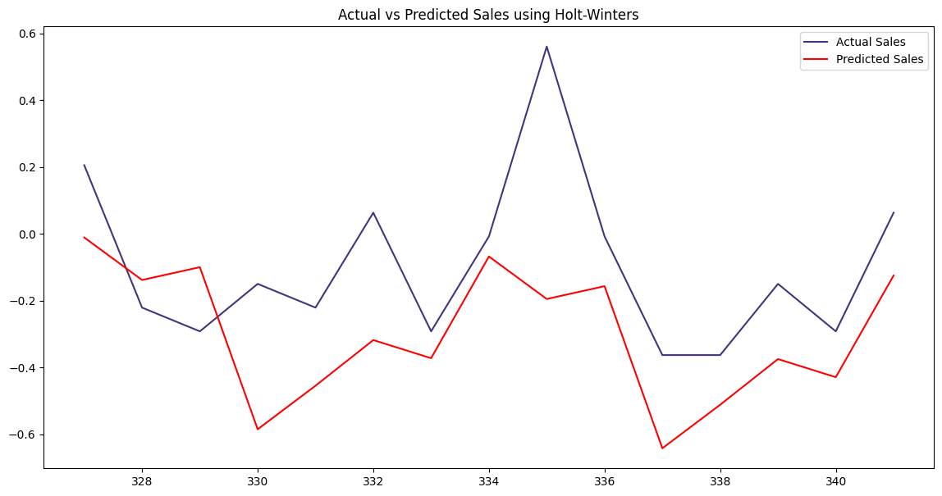
Exponential Smoothing (Holt-Winters)
Simpler does not always mean accurate
Complexity does not always mean slower

Slide 27
Prophet
Open-Source additive time-series forecasting model
Meta (Facebook)
More effective over longer periods

Slide 28
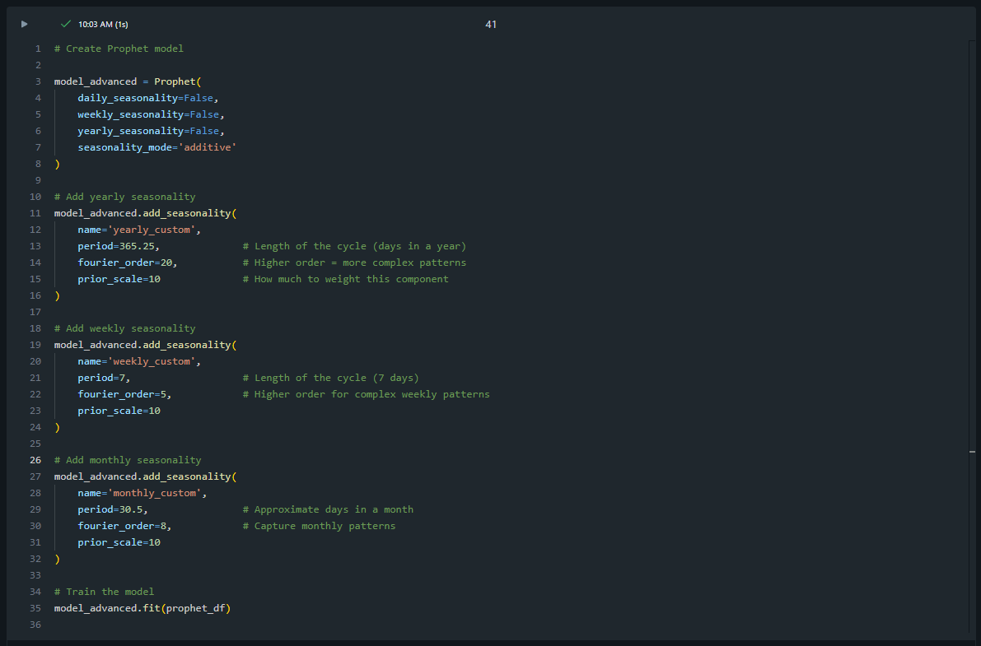
Prophet

Slide 29
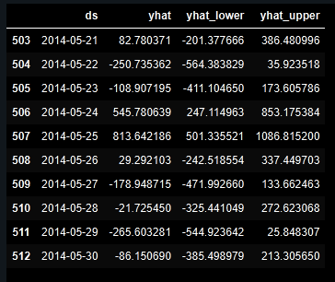
Prophet

Slide 30
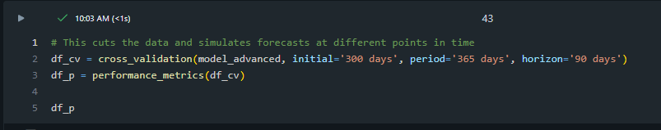
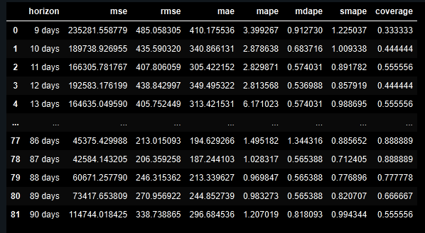
Prophet

Slide 31
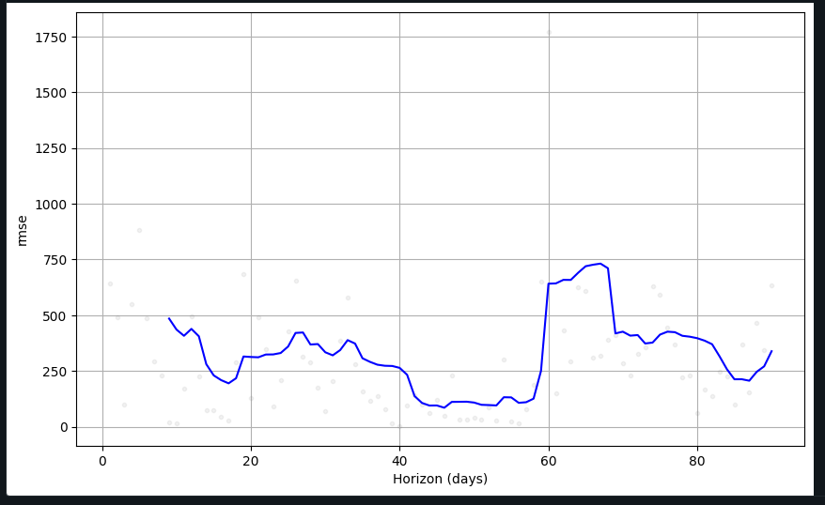
Prophet

Slide 32
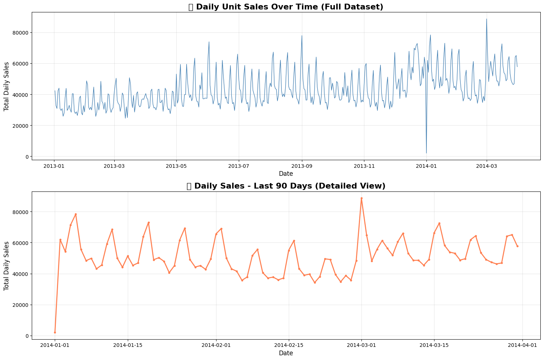
Prophet

Slide 33
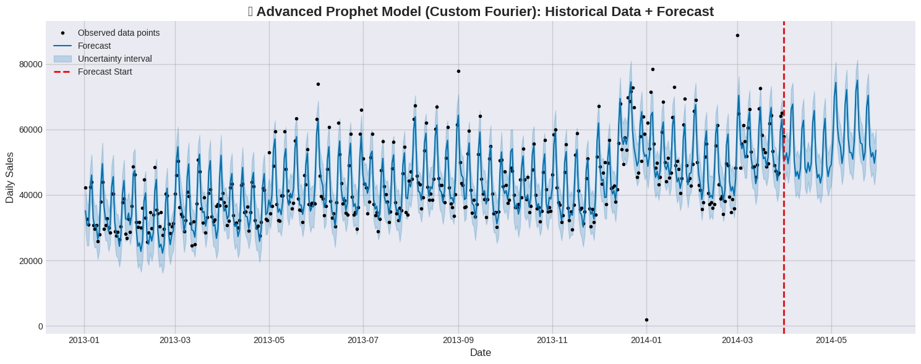
Prophet

Slide 34
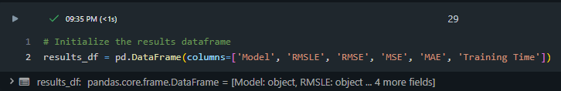
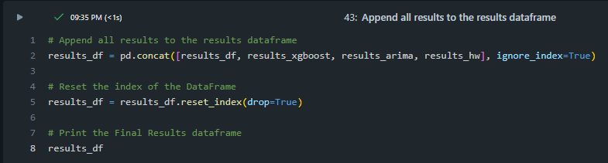
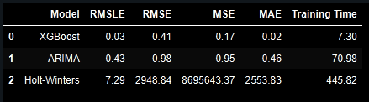
Comparison

Slide 35
Comparison

Slide 36
Best Model
XGBoost
High Efficiency
High Accuracy
Can be used across multiple stores and items in a single model

Slide 37
Challenges & Reflection
Prophet
  Initially confusing
  Inaccurate predictions
    Limited Timeframe
  Inefficient
Each model has strengths and weaknesses
  Bound by the data used or the desired result

Slide 38
GitHub Repository
https://github.com/LoGiProjects/Time-Series

